Slide 1


Harris Blitzer Sports & Entertainment
SENTIMENT ANALYSIS OF TWEETS ABOUT NJ DEVILS
DREXEL UNIVERSITY DATATHON 2022
TEAM: INFOMANICS
Neelam Arya
Tram Phan
Nam Dang
Jingxin Yao
Sunita Barik
Sakshi Panwar

Slide 2
OBJECTIVE
TO INCREASE THE SOCIAL MEDIA ENGAGEMENT OF NEW JERSEY DEVILS

Slide 3


METHODOLOGY
RESEARCH QUESTION
TEXT MINING
TEXT ANALYSIS
SENTIMENT ANALYSIS
CONCLUSION

Slide 4
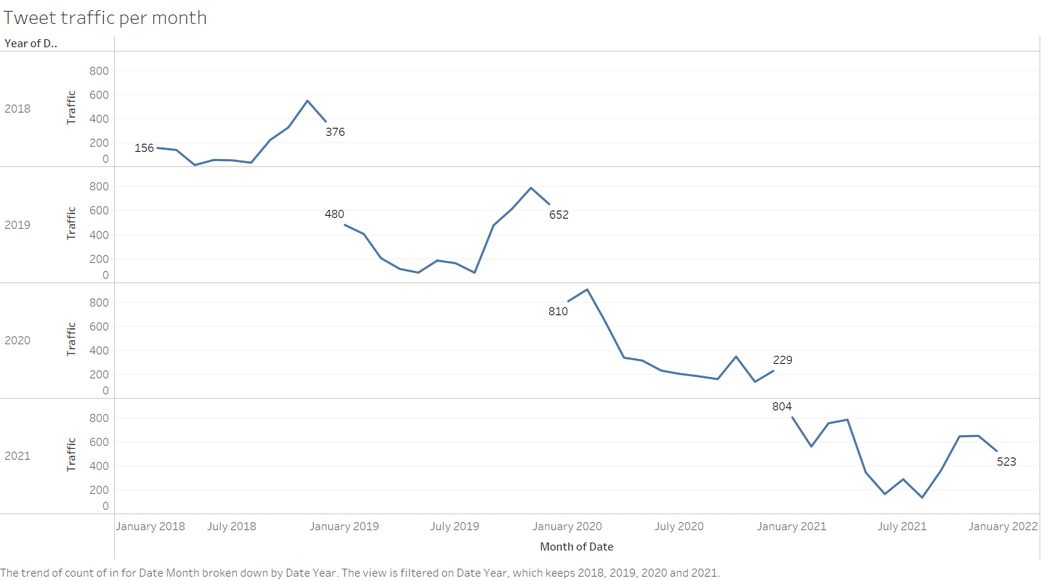

Tweet traffics from 2018-2021
Traffic is usually highest at the end of the year (around Oct – Nov), with the exception of 2020 due to Covid-19
: Highest traffic periods

Slide 5
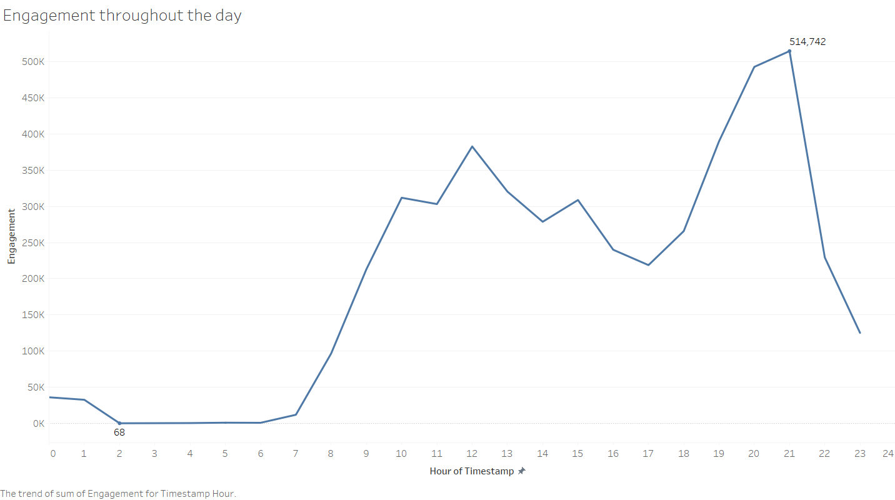
Hours that have highest impact in the day
Within the hours of the day, traffic is usually highest at 20:00 – 22:00
: Highest traffic periods

Slide 6
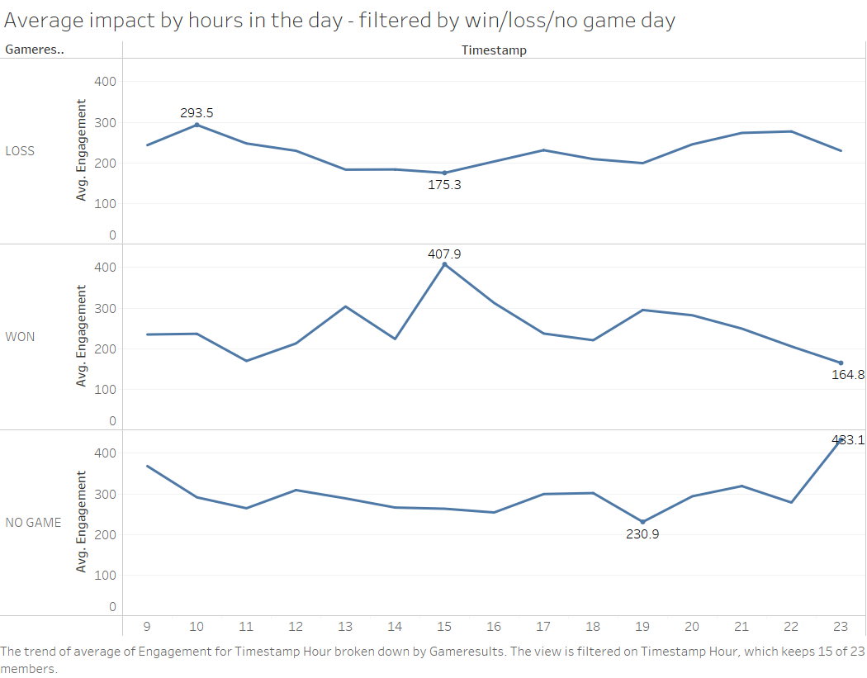
Hours that have highest impact in the day
Winning Matches: Average impact is highest surprisingly at 15:00 PM.
Losing Matches: Impact stays the same
No Game days: Highest at 22:00 – 23:00 PM
Opportunities:
Need to engage on twitter more during losing matches.
: Highest traffic periods

Slide 7
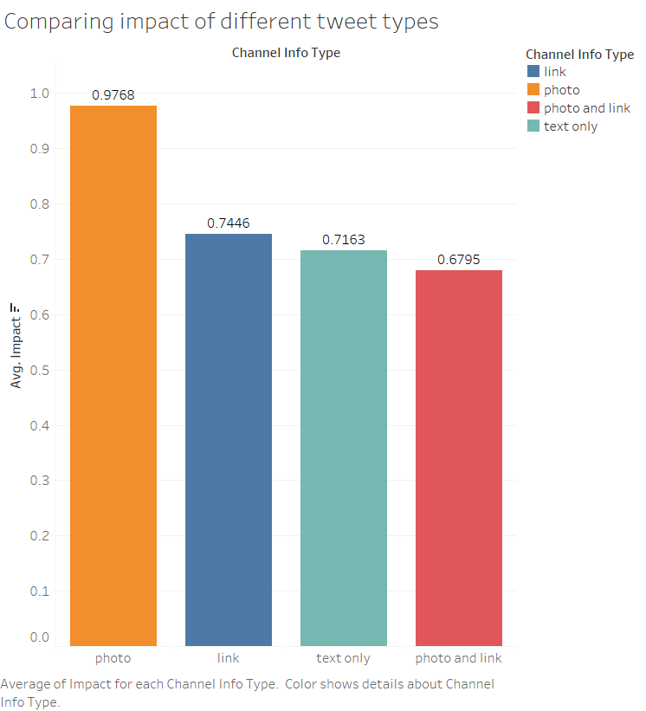
Impact of different types of tweet
Tweets with photos only has the highest average amount of impact.
Other types of tweets have approximately equal impact.
Opportunities:
Tweets should include images that captivates fans to interact.

Slide 8
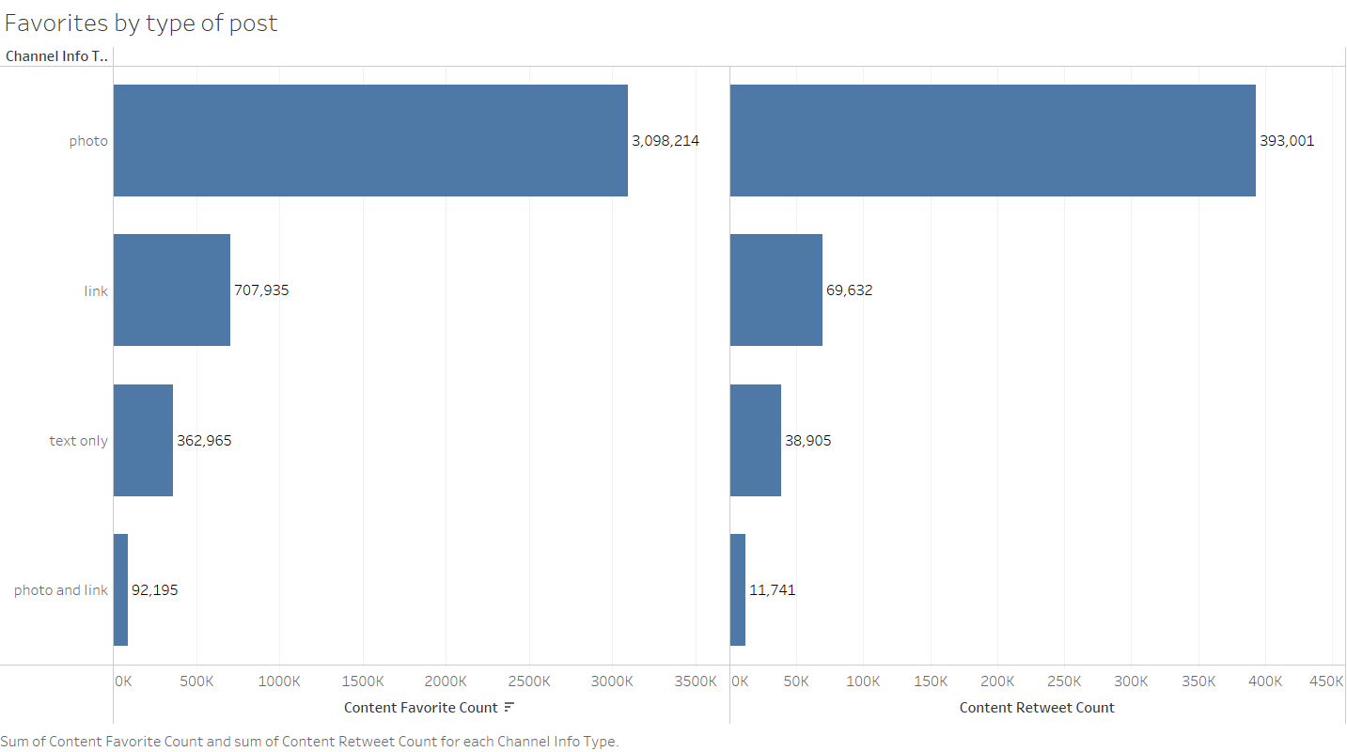
Content Favorite and Retweet

Slide 9
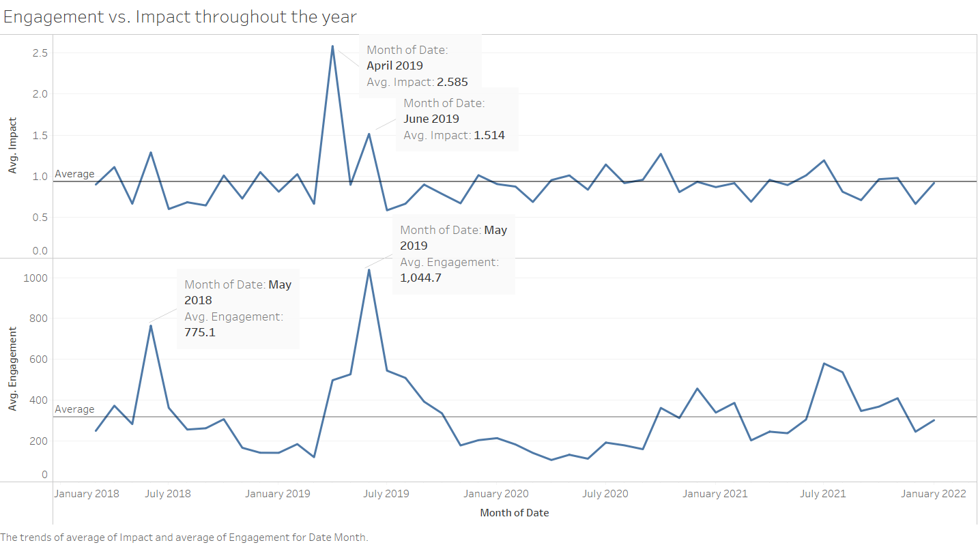
Engagement vs. Impact throughout the year

Slide 10
Analysis
S

Slide 11
Methodology
blank

Slide 12
THANK YOU

